Slide 1

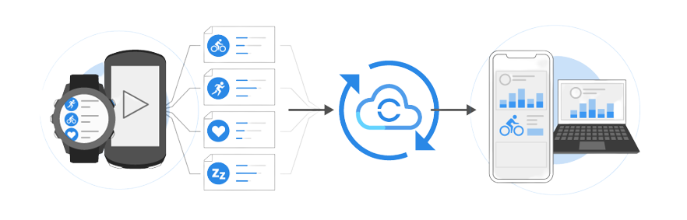
oachingMate Garmin API
GA-BoxJelly
Name | Role
Zhidong Zhou | Product Owner
Lingjun Meng | Development Lead
Yuanwei Mao | Developer & Testing Lead
Jialiang Cheng | Scrum Master
Ruiying Feng | Quality Assurance Lead

Slide 2
Outline
01
02
03
04
Background
Technology & Deployment
Zhidong Zhou
Yuanwei Mao
05
Handover
Product DEMO
Fulfillment
Lingjun Meng
Ruiying Feng
Jialiang Cheng

Slide 3
Background
GARMIN Connect
Project Scope
Coaching-Mate

Slide 4
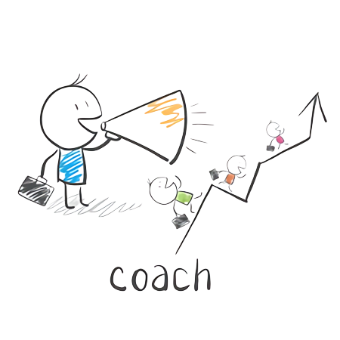
Coaching-Mate
- Coach
- Training Sessions
- Athlete Review
- Web Application

Slide 5
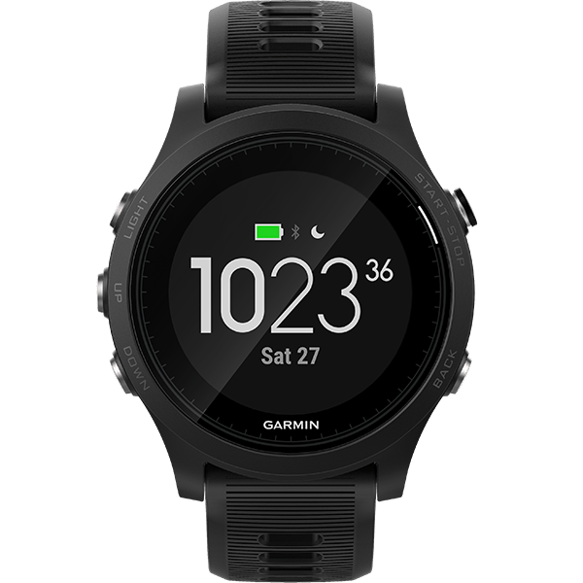
Garmin
- DATA from Wearable Device

Slide 6

Project Goal
- Data from Garmin Connect
- Activity Data
- Activities Detail
- Based on Previous Code

Slide 7
Technology & Development
Deployments
Technology

Slide 8
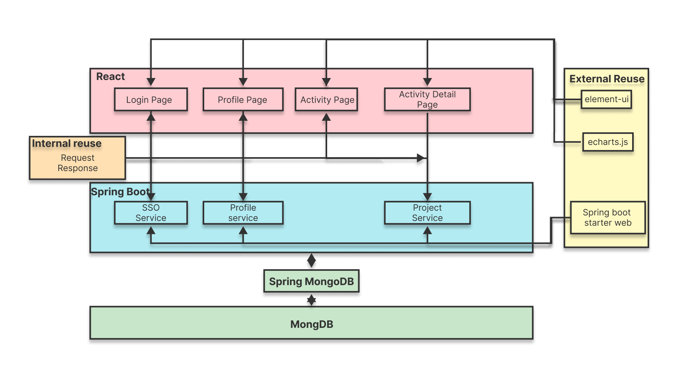
Technology

Slide 9
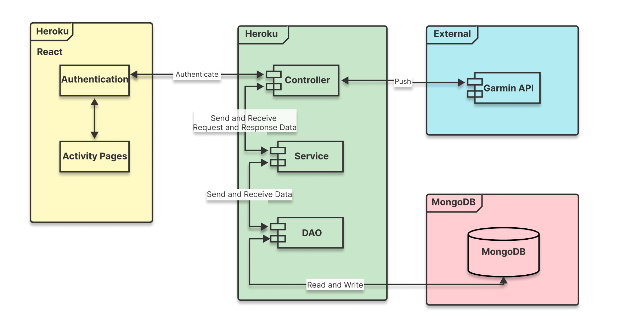
Deployment

Slide 10


Slide 11

Code Improvement
1. Remove code repetition 2. Add error handle 3. Uniform the responses

Slide 12
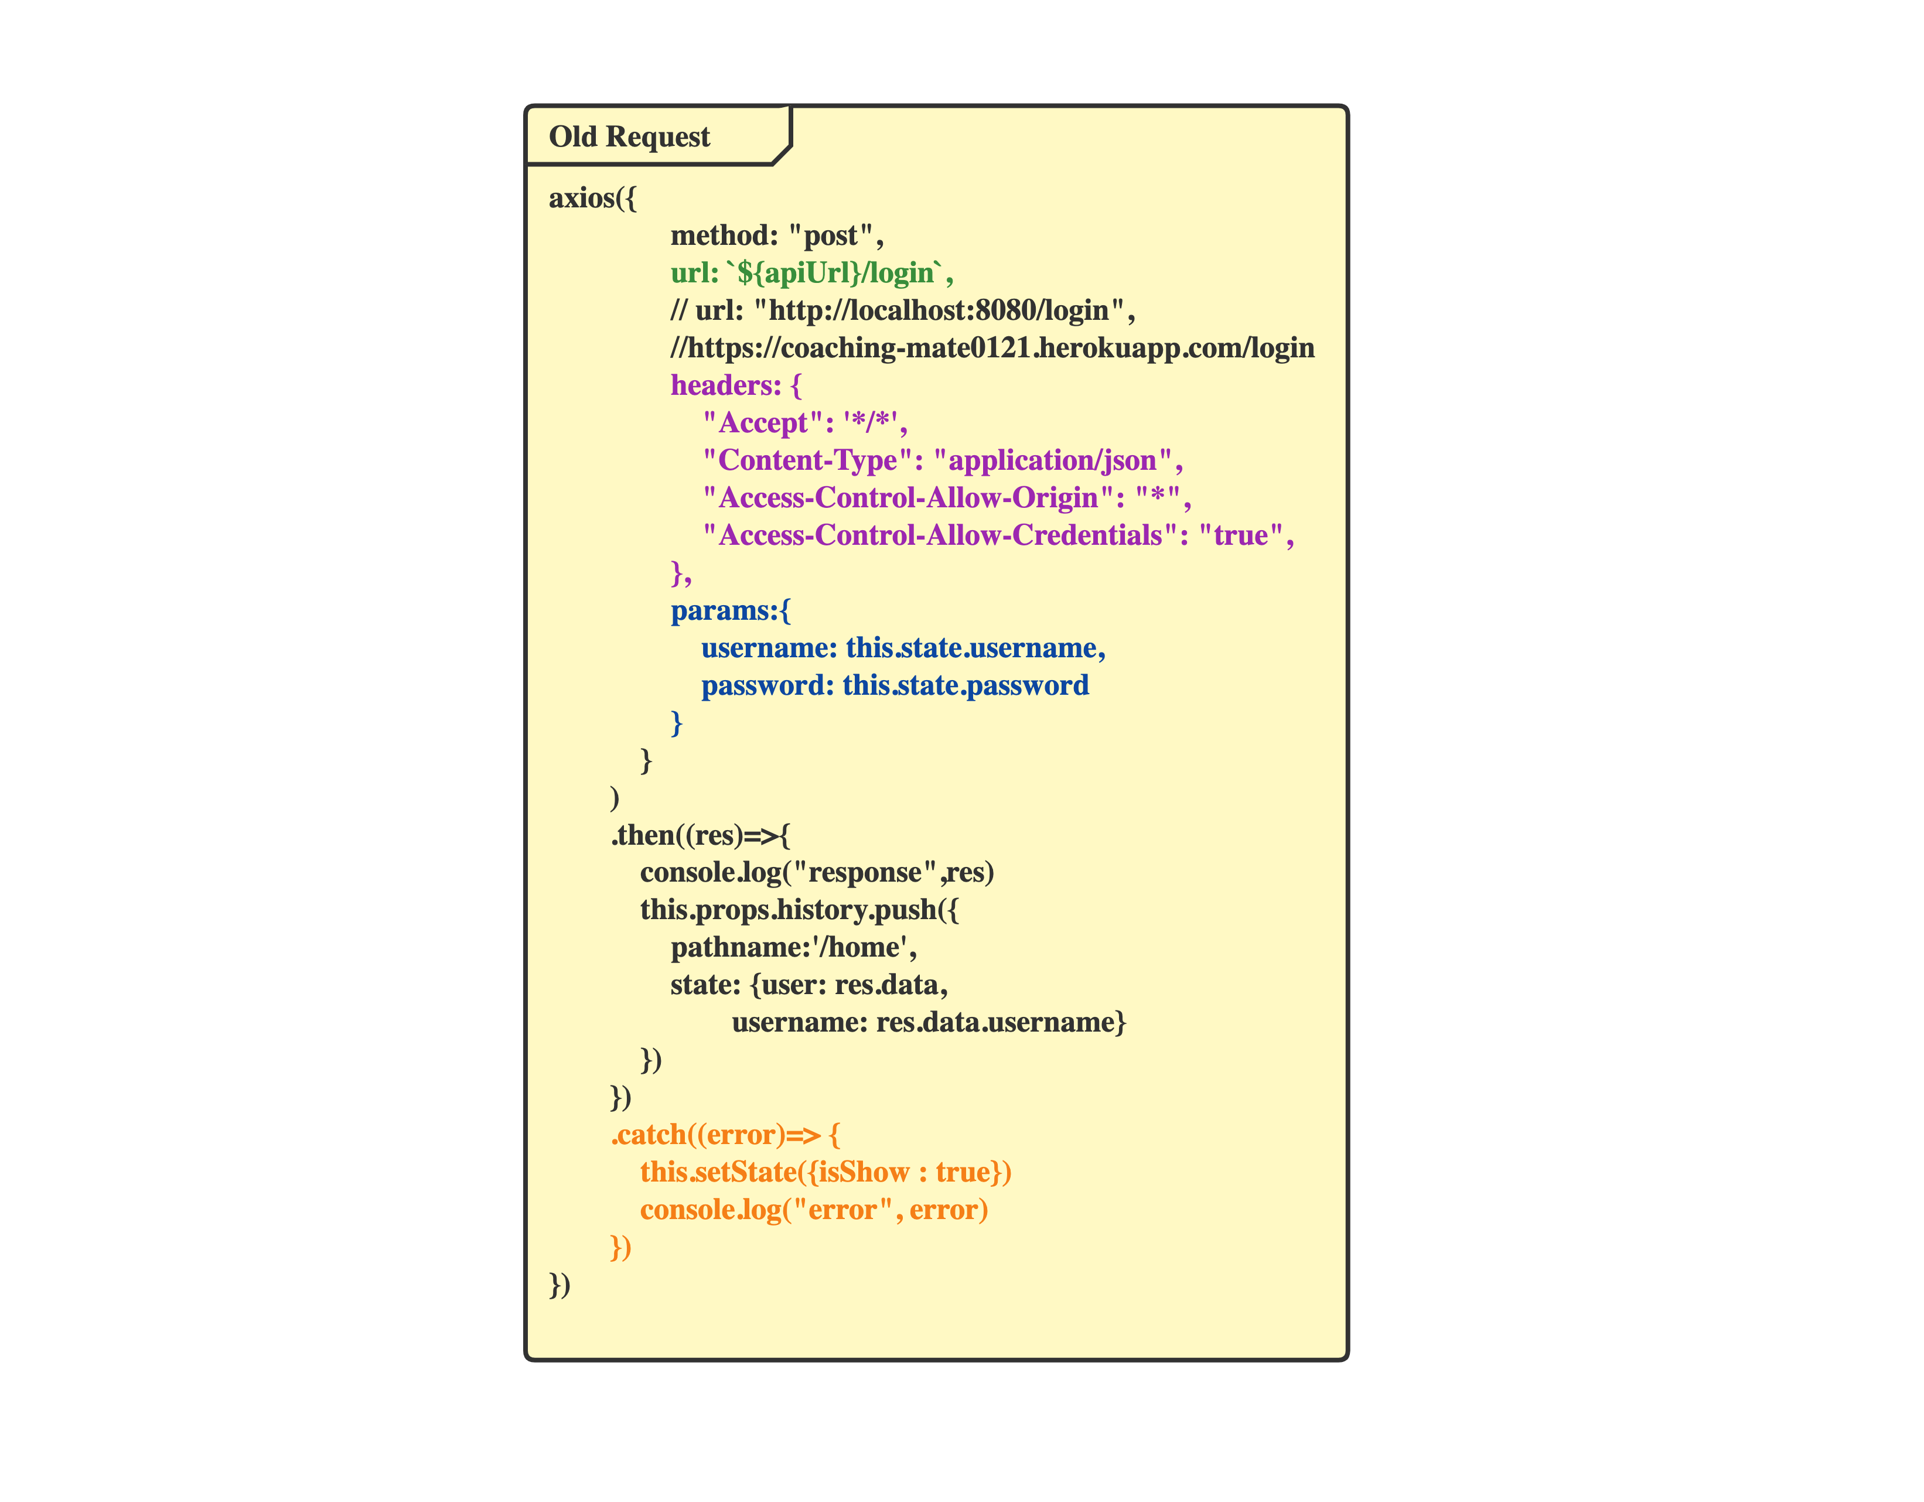
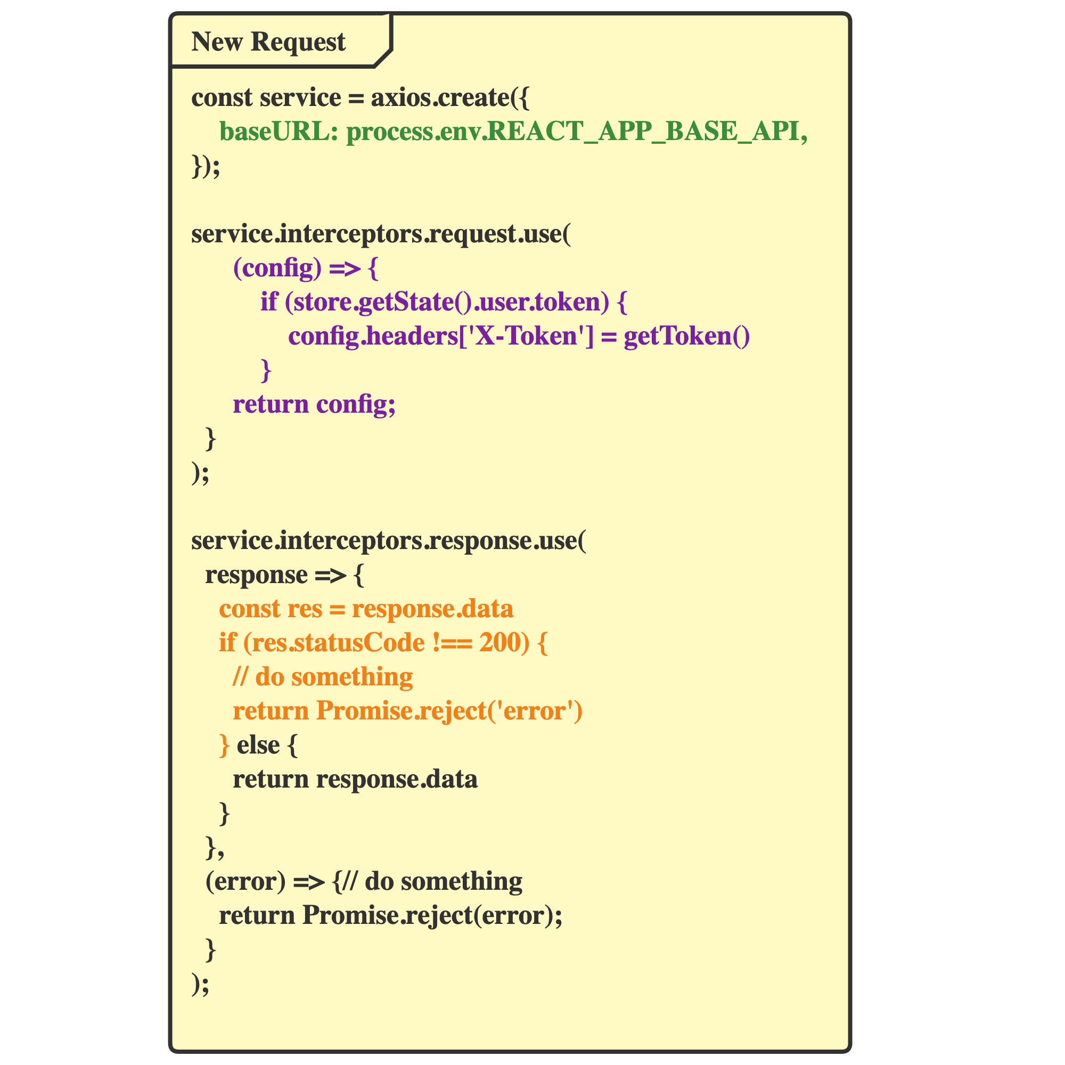
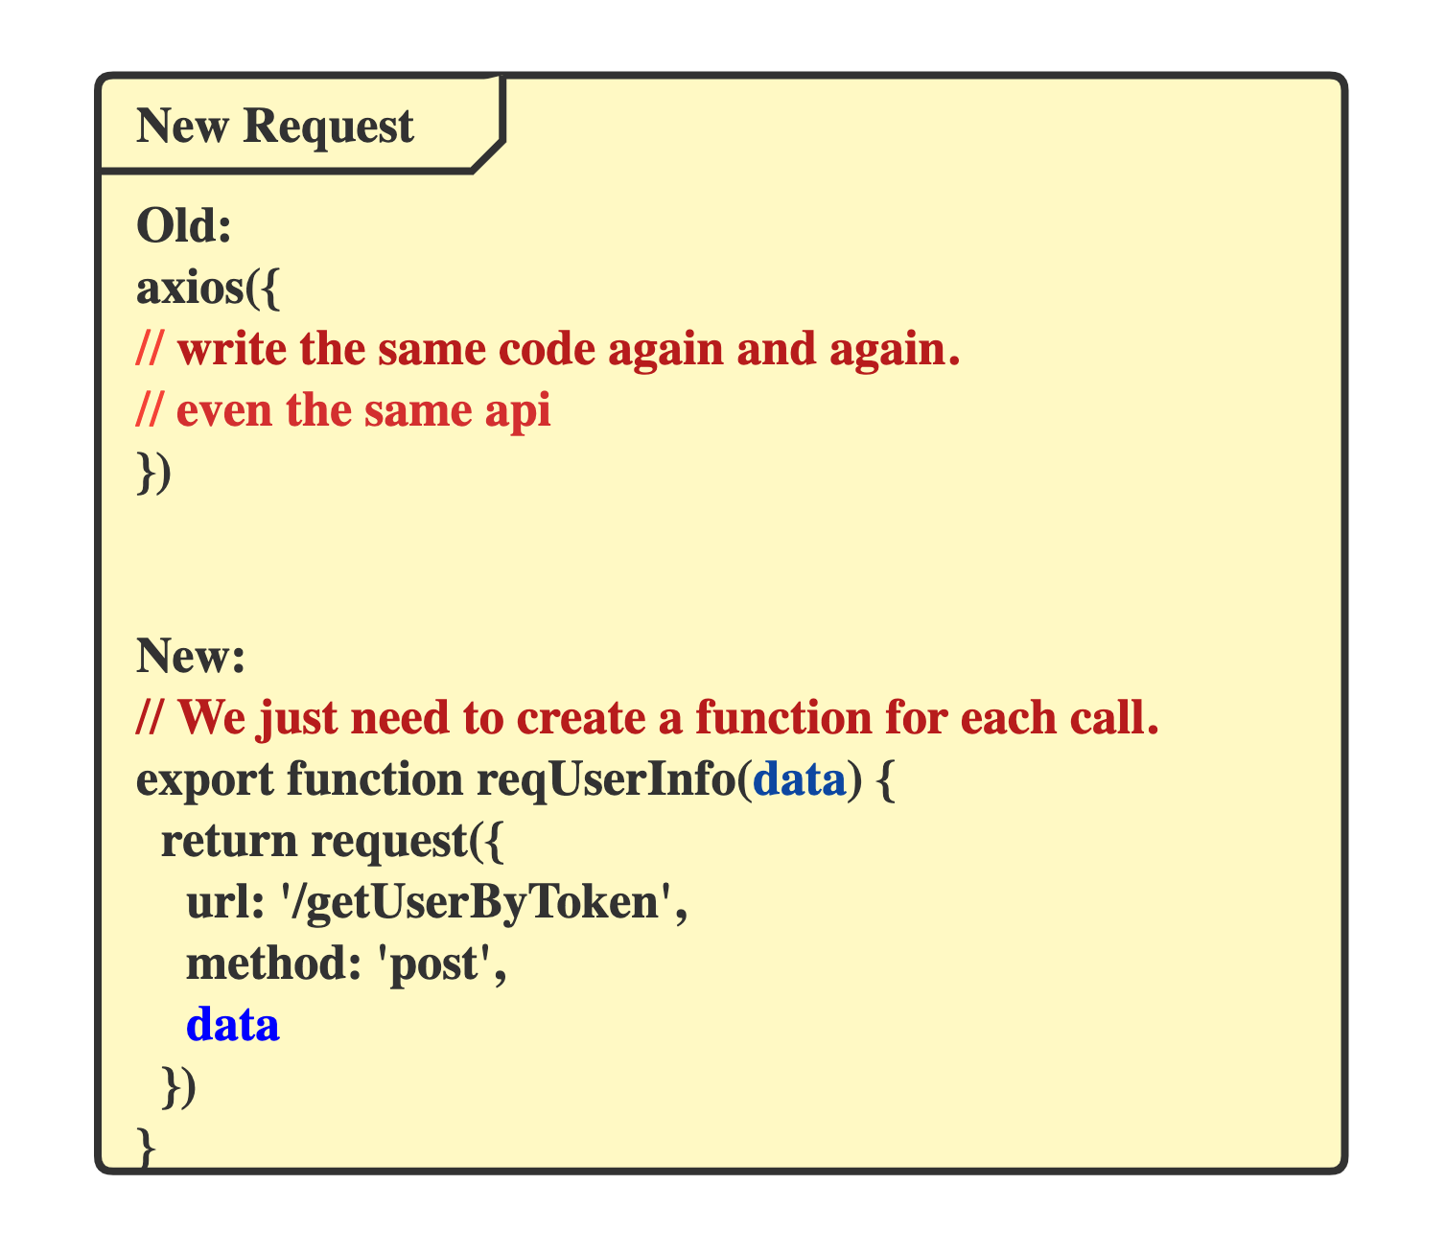

Slide 13
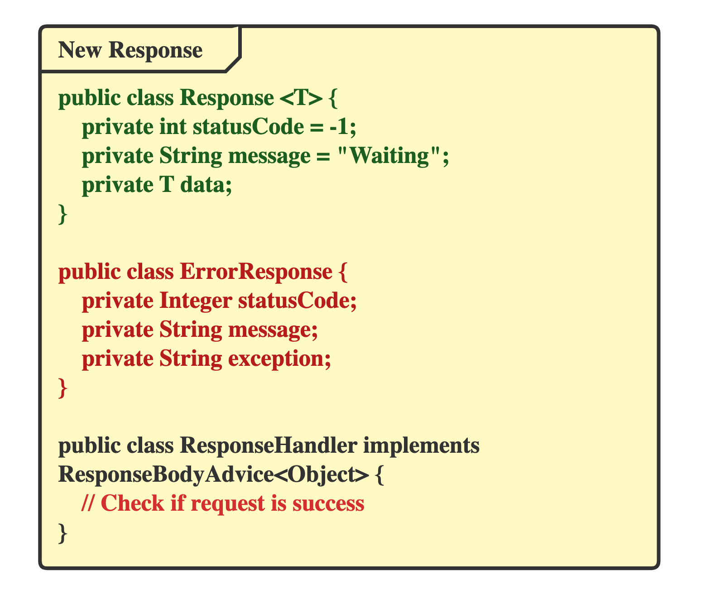
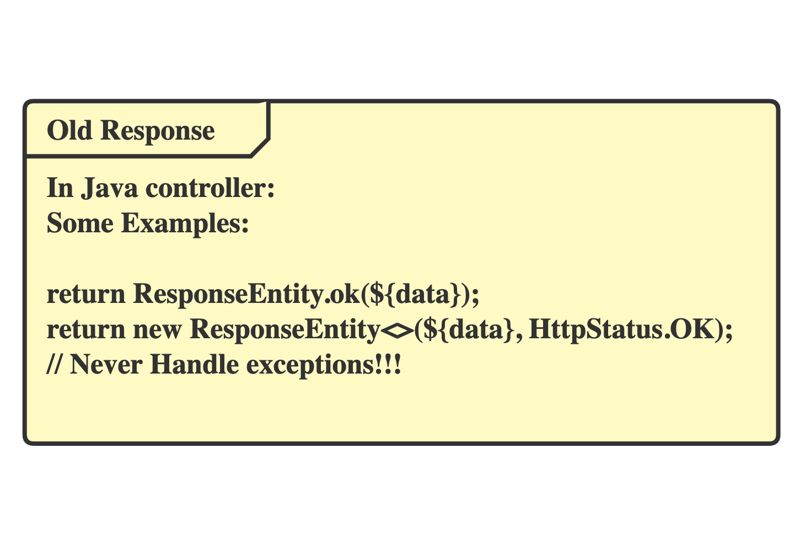
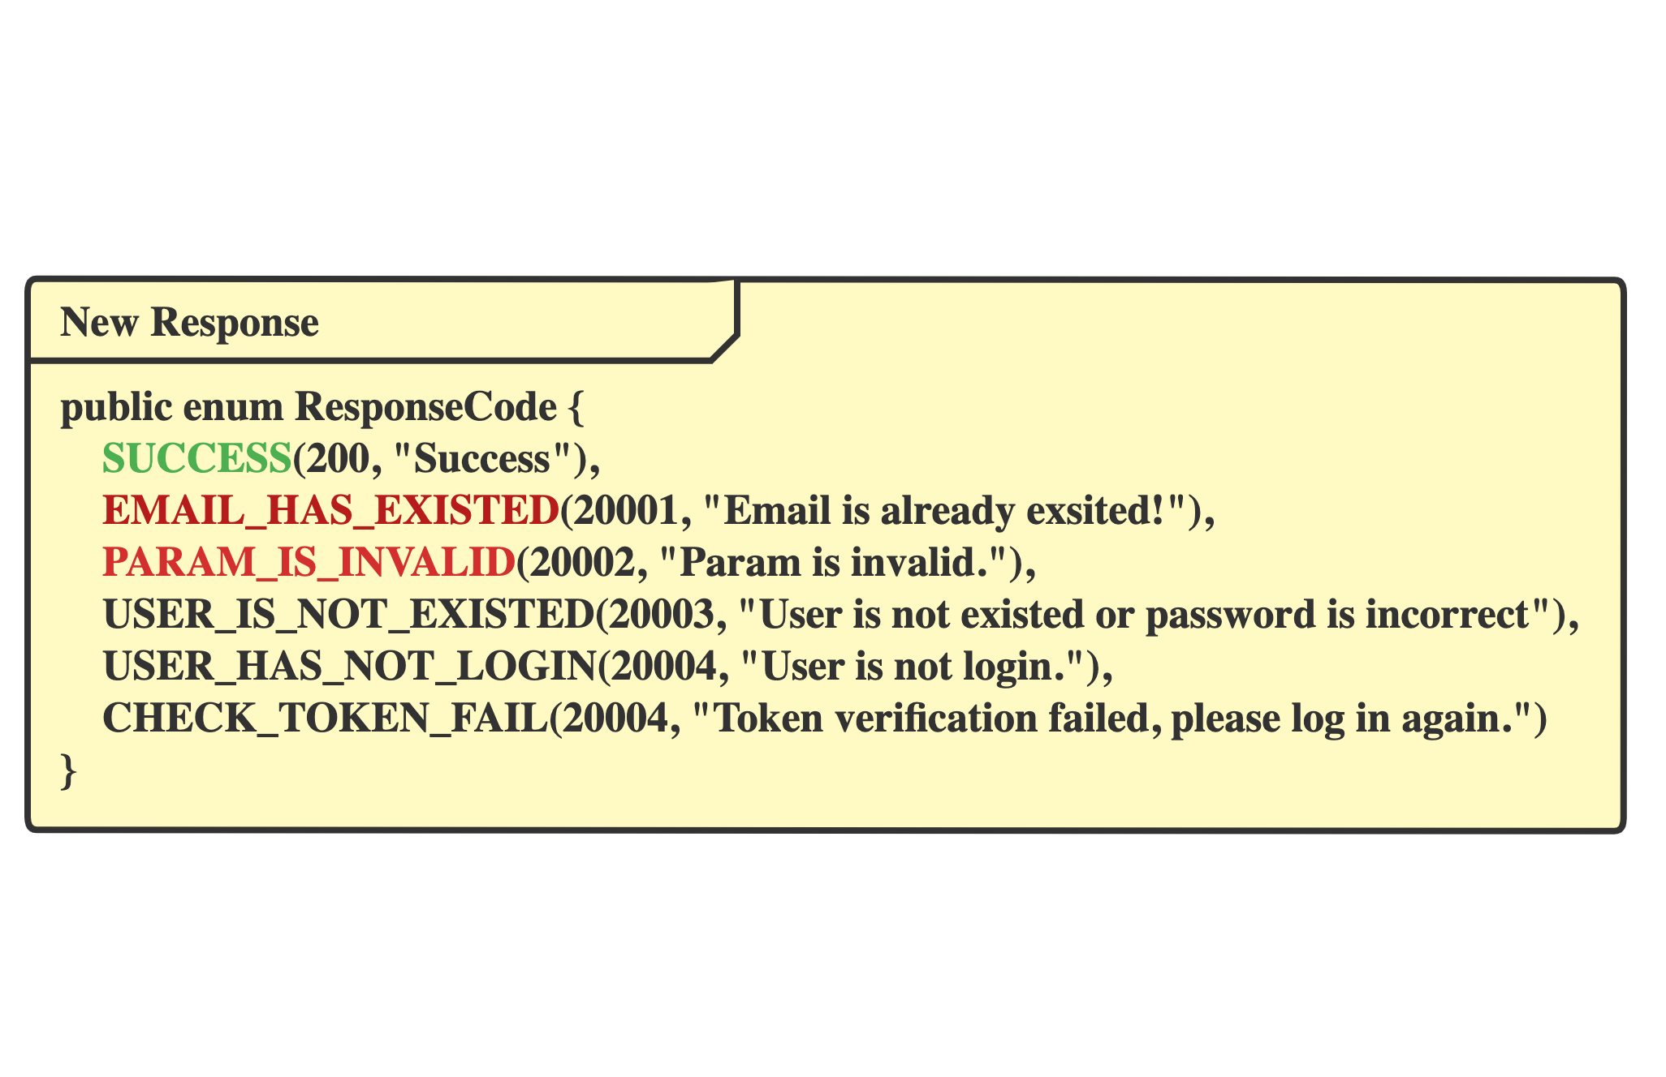


Slide 14

Testing
1. Unit Test
2. Integration Test
3. Acceptance Criteria & Test

Slide 15

Task fulfillment
- In scope
- Coaching-mate account management
- Garmin-API connection
- View Synchronized activity data
- Out scope
- Website design
- Analyze the data
- Future demand
- Retrieve password

Slide 16
Deliverables
Would be delivered
Mainly 2 parts:
On
June 13th
- Code
- Documents

Slide 17
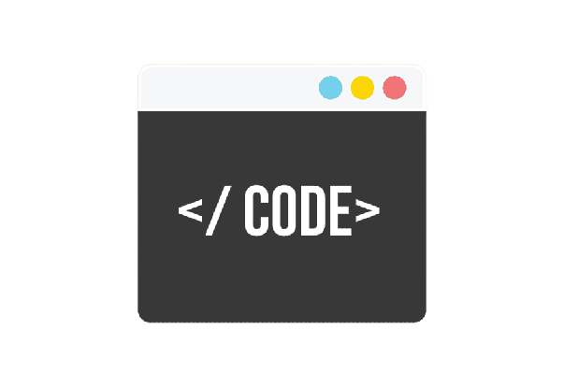
Code
- Front end
- React version
- Back end
- Upgrade version - based on the previous team

Slide 18
Documents
Requirements analysis
Development specification
- Project Background
- Motivation Model
- Personas
- User stories
- Technology
- Deployment
User Manual
Quality control
- Test cases
- Acceptance criteria
- Acceptance test
- Deployment Guideline
- Database structure

Slide 19
Thanks
< Question Time >

